Slide 1

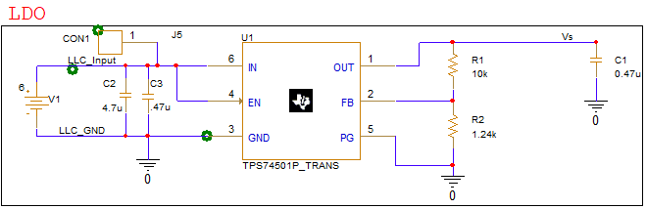
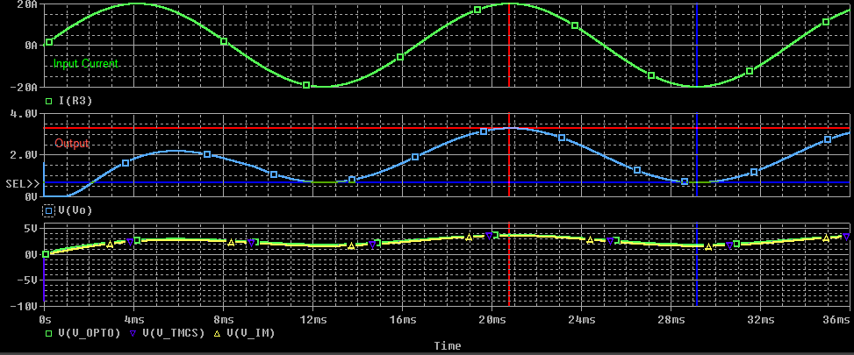
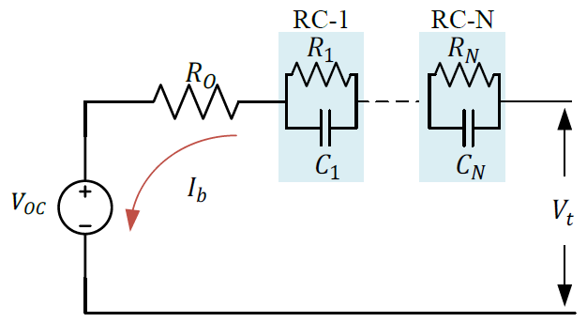
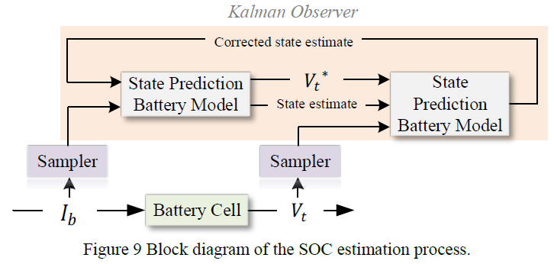
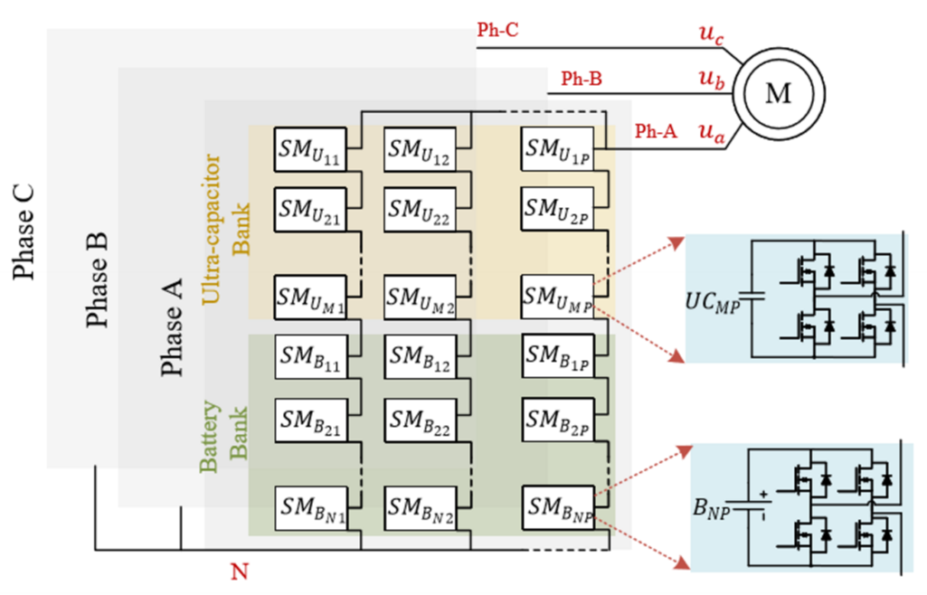
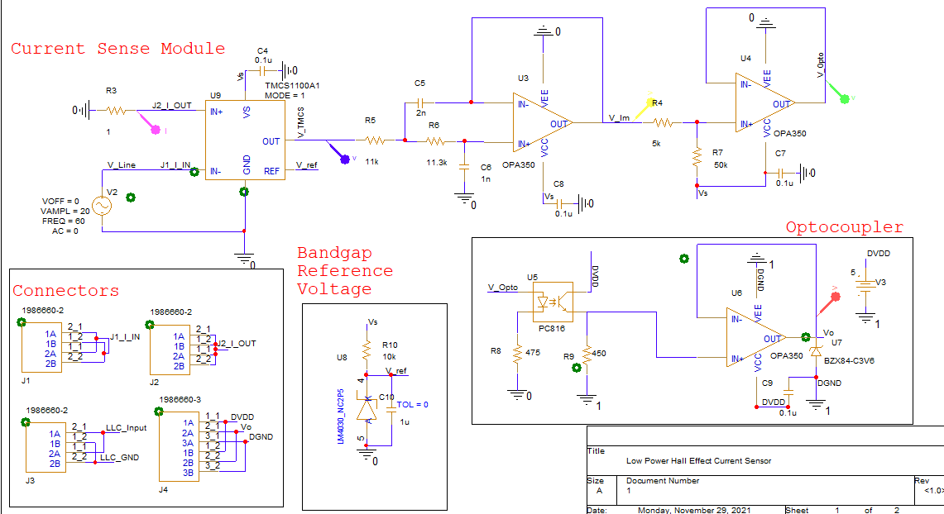
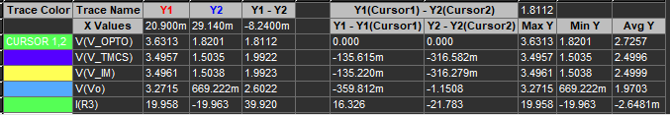
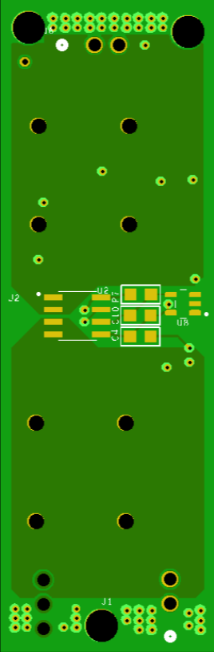
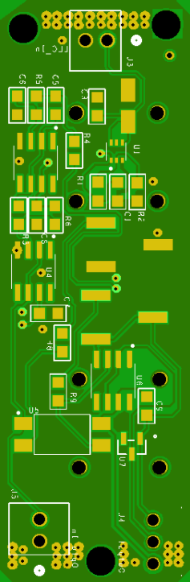
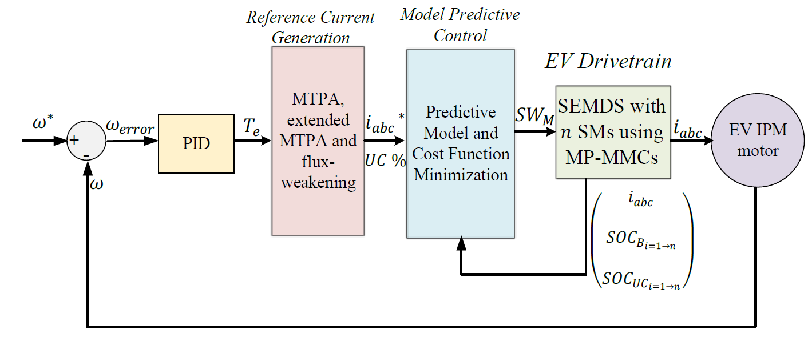
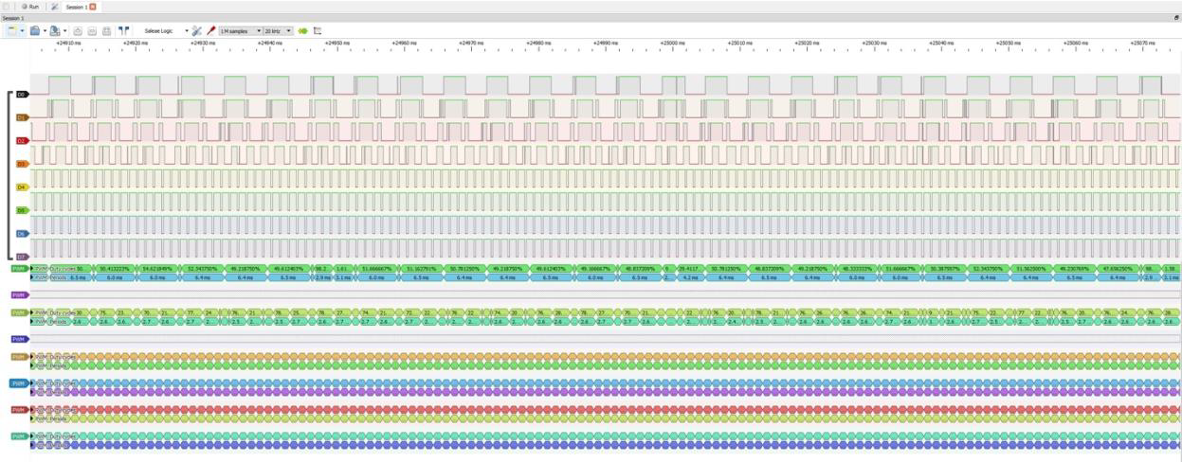
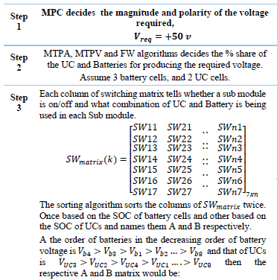
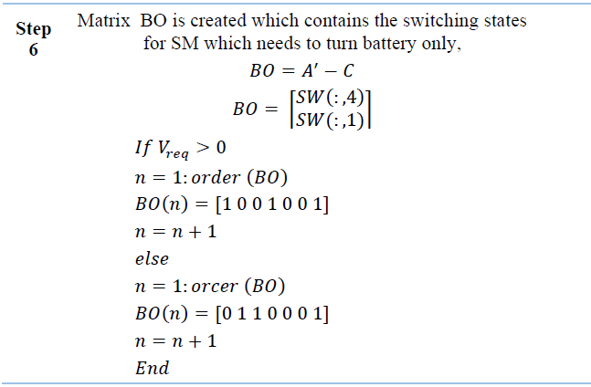
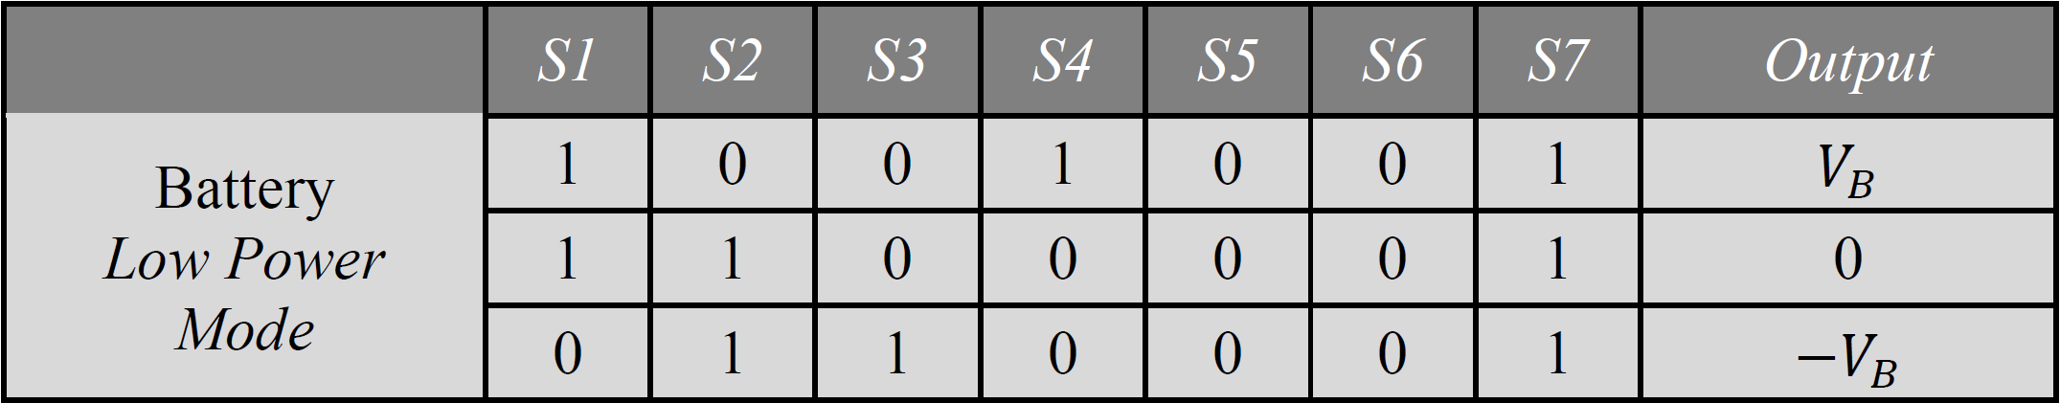
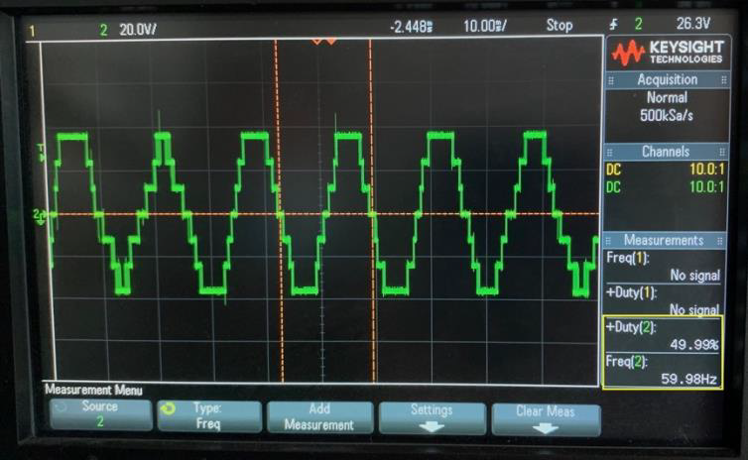
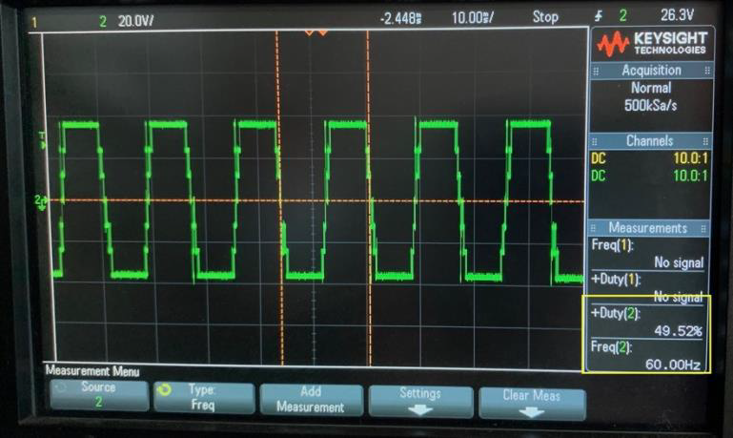
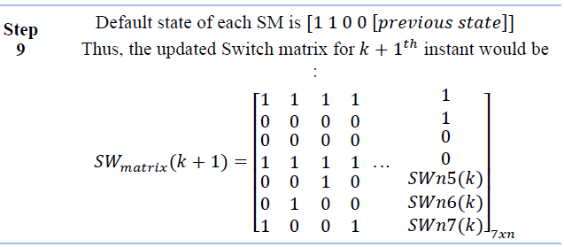
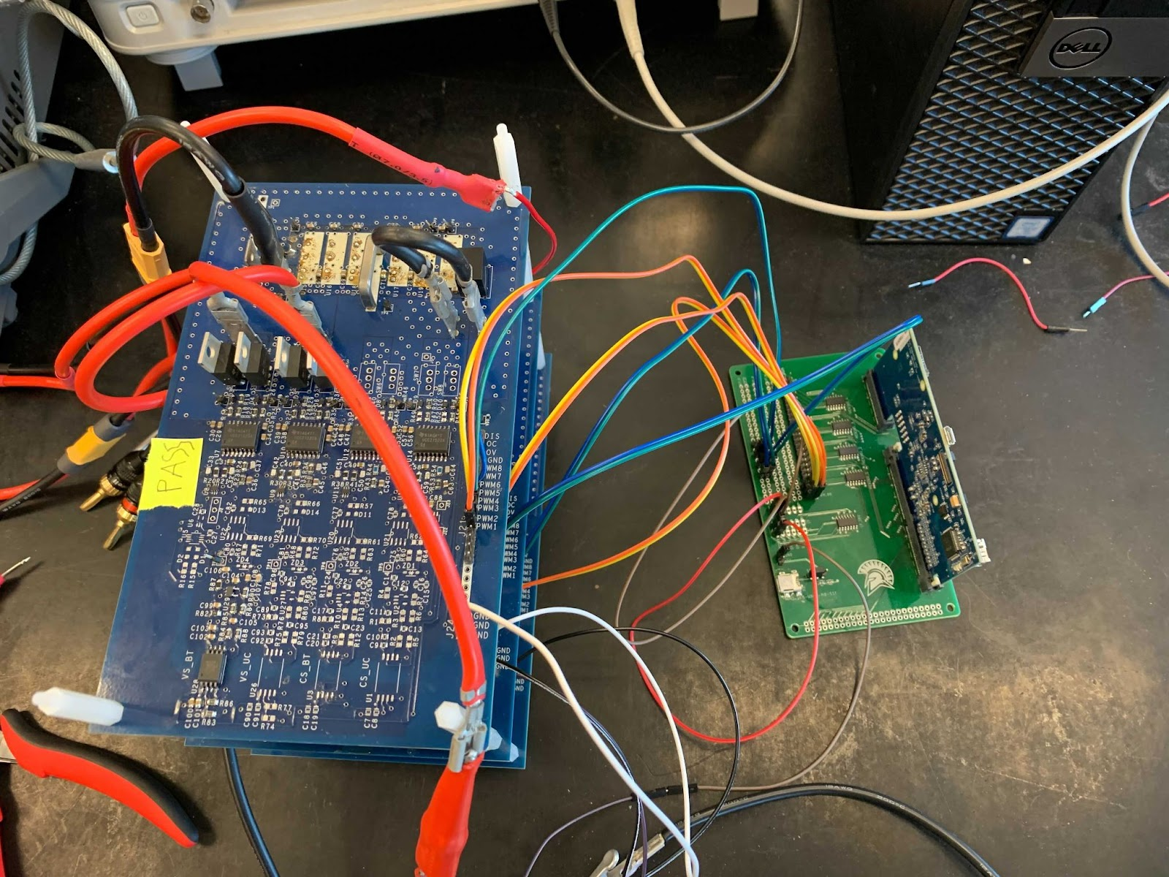
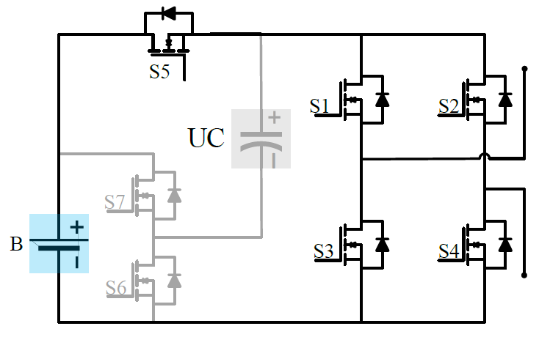
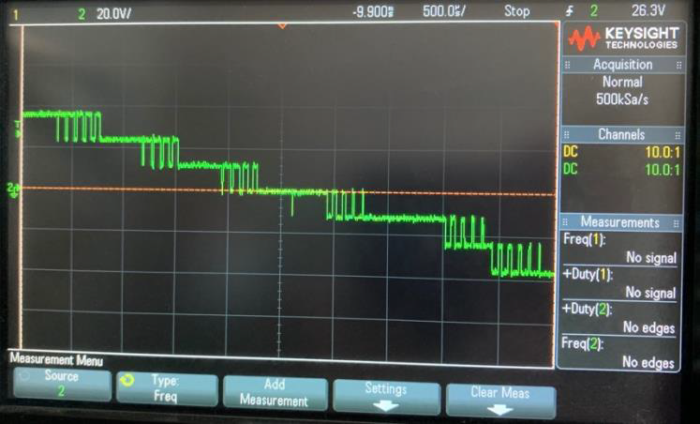
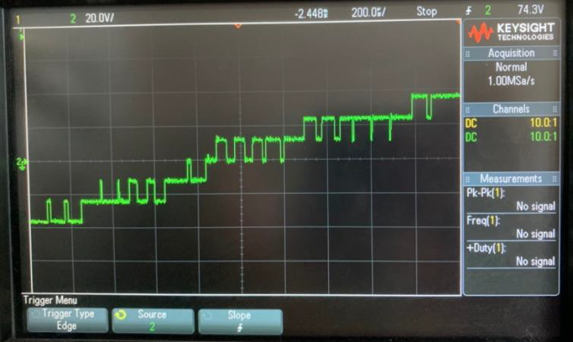
Electrical Engineering Department
Energy Management System (EMS) for Storage Cells in Electric Vehicles
Project Advisor: Dr. Mohamed Badawy
Tran, Andrew (BS Electrical Engineering)
Saito, Hiromi (BS Electrical Engineering)
Austin, Jonathan (BS Electrical Engineering)
Introduction
Methodology
Analysis and Results
The EV industry has been growing at a rapid pace and it is projected to grow at an exponential rate over the next decade. Current standards for EVs include separate inverter and battery system which results in more expensive manufacturing and maintenance costs. The goal of our project is to replace the system level inverters with a modular multilevel converter (MMC) in order to reduce efficiency losses due to DC to AC conversion.
Figure 11: Equivalent Li-ion battery cells circuit model
Figure 12: SOC Estimation Kalman Filter Block Diagram
Much of the work done on SOC Estimation with the Kalman Filter (Figure 12) was spent in the research phase of compiling the simulation work done by previous project members (Figure 11) and planning out how this functionality could ultimately be converted into C code and implemented in the main code.
Figure 7: Current Sense Simulation Results
Summary/Conclusions
For the Power Module team, this project was to redesign a part of the MMC. By incorporating an LDO that was powered by the LLC Resonant circuit, the optocoupler, the Power Module team was able to resolve some issues from the previous iteration.
Transferring the reiterated current sense design from schematic to PCB involved the PMD team gaining experience in PCB editing software. OrCad PCB editor was the chosen software for creating the PCB and offered great experience as it operates at a relatively low level compared to other industry standard PCB editing software. In relation to the current sense board and high current, the PMD team had to design cautiously to ensure the current sense board could adequately operate under load.
The Embedded Systems team has designed, implemented, and tested a more efficient sorting algorithm into the main code. Along with this, the team has also laid the ground for the next step of improvement and implementation for the Kalman Filter. Throughout this project the team gained experience in programming and understanding how software can interact with the hardware system. The remaining future work that can be done will include slowly introducing more functionality into the main code.
Figure 1: System Model
Figure 4: Redesigned Current Sense Module
This project consists of two main sections: the Power Module team and the Embedded Systems team. The Power module team worked on simulating and designing a PCB for the current sense module that would sense the current from the inverter and send a signal to the FPGA. The Embedded Systems team’s work consisted of researching, writing, implementing, and testing code at home and on the lab hardware with the DSP controller. The algorithms used were documented in Dr. Badawy’s published IEEE papers.
Figure 4 shows the schematic for the redesigned Current Sense Module. The redesigned Current Sense features an LDO, a two-stage Butterworth filter, and an optocoupler to provide isolation between the analog and digital grounds.
Figure 8. Generated View of the Top and Bottom Layers by Bay Area Circuits
Figure 7 shows the voltage or current waveforms from different parts of the Current Sense module. Major obstacles for designing a PCB is minimizing the footprint of the board, considering the mechanical limitations of the components and following the constraints designated by the chosen PCB manufacturer, and designing safely for high current applications (maximizing ground impedance/area of high current copper pour contacts).
Methodology
The current hardware for the Modular Multilevel Converter (MMC) consists of a current and voltage sensor, an inverter board, gate drivers, an H-bridge Circuit (Figure 3), and a digital signal processing (DSP) controller (Figure 2). The purpose of the sensors is to track the voltage and current levels and send them to the FPGA. The gate drivers are used to control the MOSFET’s switching times of when it turns on and off. The H-bridge circuit is responsible for generating the PWM signal that would be sent to the motor. The DSP controller holds the PWM modules that would be used to turn on or off the switches of the H-bridge shown in Table 1.
Figure 5: State of Charge (SOC) Adapted Sorting Algorithm
Figure 6 shows a simplified version of the SOC sorting algorithm, which was done in order to accommodate the lack of UCs. To update the PWM modules efficiently, a PWM module matrix is made which includes the status of the four switches for each H bridge.
Key References
[1] M. Badawy, M. Sharma, C. Hernandez, A. Elrayyah and J. Coe, "Model Predictive Control for Multi-Port Modular Multilevel Converters in Electric Vehicles Enabling HESDs", IEEE Transactions on Energy Conversion, pp. 1-1, 2021. Available: <https://ieeexplore-ieee-org.libaccess.sjlibrary.org/document/9457037> [Accessed 29 November 2021].
[2] S. S. George and M. O. Badawy, A Modular Multi-Level Converter for Energy Management of Hybrid Storage System in Electric Vehicles, 2018 IEEE Transportation Electrification Conference and Expo (ITEC), Long Beach, CA, USA, 2018, pp. 336-341, doi: 10.1109/ITEC.2018.8450237. Available at: <https://ieeexplore-ieee-org.libaccess.sjlibrary.org/document/8450237> [Accessed 29 November 2021].
Table 1: Sub-module Converters Switching States
Figure 9: PWM waveforms with level 4 on DSP
Figure 6: State of Charge (SOC) Adapted Sorting Algorithm
Acknowledgements
Test code was written to verify the algorithm, was then implemented into the main code and tested on the DSP to get the result in Figure 9. Once it was successfully tested on the DSP, it was then tested on the hardware setup in the lab to generate the outputs shown in Figure 10.
We would like to thank Dr. Mohamed Badawy for his research resources and guidance throughout this project. We would also like to give a big thank you to all the other students that we worked with on this project, especially the masters students who gave us so much help with giving us tasks and helping us through them.
Figure 2: MMC & DSP Setup
Figure 3: H-Bridge Circuit
Figure 10: Waveforms before (left) and after (right) SOC Algorithm

